Slide 1
IETF 85: Atlanta, GA
NOC Report

Slide 2
Network Overview
2x 1 Gb/s link to Telus
Networks 130.129.0.0/16 and 2001:df8::/32 advertised via AS# 56554
New RIPE space
Full gigabit infrastructure
IETF network extended to Hilton guest rooms via 1GB/s copper link

Slide 3
Network Overview
Implementation SIDR route origin checking using the Resource PKI (See slide for details)
Advertising new RIPE address space: 31.130.224.0/20, 31.133.128.0/18, 2001:67c:1230::/46, 2001:67c:370::/48
Having unofficial ROAs generated for the address space we're using. Hope to work with RIPE to generate an official ROA.

Slide 4
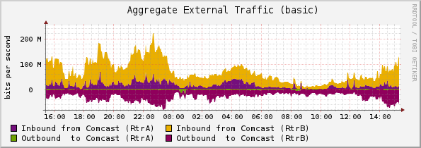
External Traffic

Slide 5
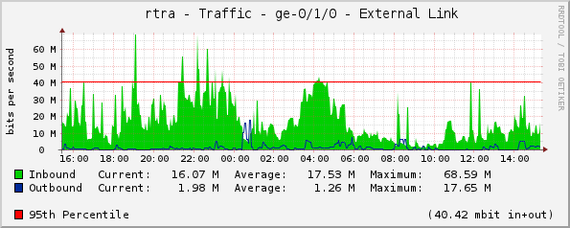
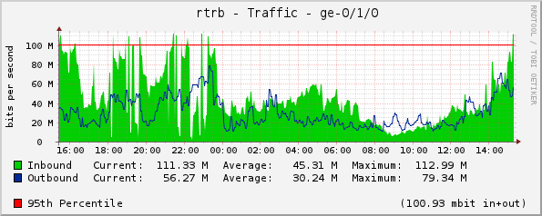
External Traffic (cont.)

Slide 6
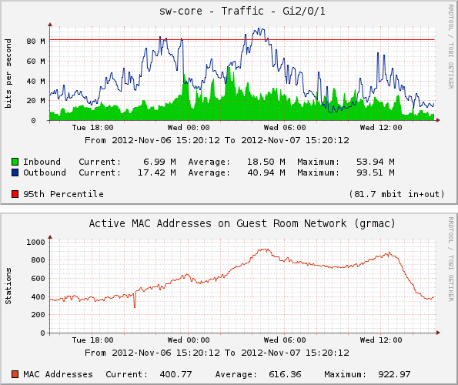
Guestroom Usage

Slide 7
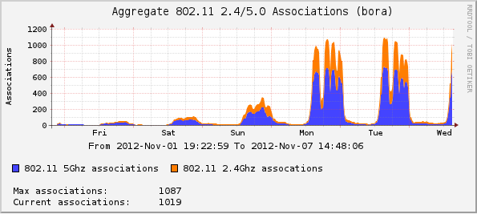
Wireless Associations

Slide 8
A special thanks to…
Bill Fenner (in abstentia)
Bill Jensen
Bjeorn Zeeb
Chris Elliot
Joel Jaeggli
Jim Martin
Warren Kumari
Brandon Height
James Dishongh
Lance Hollandsworth
Hans Kuhn
Nick Kukich
Edward McNair

Slide 9
Thank You
Telus
Juniper
Connectivity
Gear donation (Routers)
Google
Cisco
Gear donation (Servers)
Gear donation (WAPs)
Radiator
Software Licenses

