Slide 1
IETF 85: Atlanta, GA
NOC Report

Slide 2
Network Overview
2x 1 Gb/s link to Comcast
Networks 130.129.0.0/16 and 2001:df8::/32 advertised via AS# 56554
Full gigabit infrastructure
IETF network extended to Hilton guest rooms via 1GB/s copper link

Slide 3
New on the IETF Network
Implementing SIDR route origin checking using the Resource PKI (See slide for details)
Advertising new official address space: 31.130.224.0/20, 31.133.128.0/18, 2001:67c:1230::/46, 2001:67c:370::/48
Having unofficial ROAs generated for the address space we're using. Hope to work with RIPE to generate an official ROA.

Slide 4
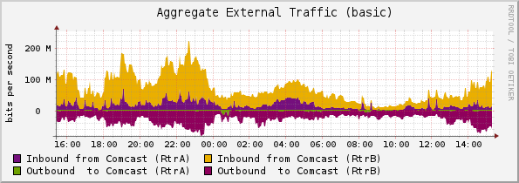
External Traffic

Slide 5
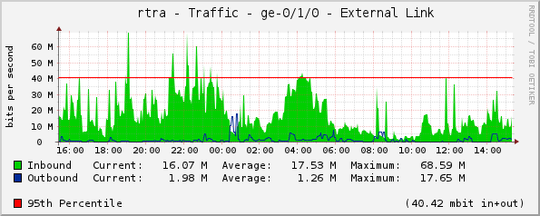
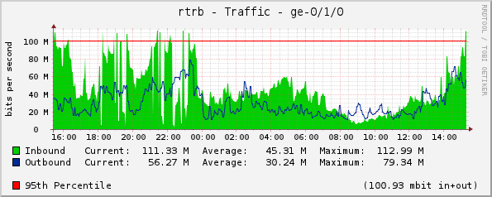
External Traffic (cont.)

Slide 6
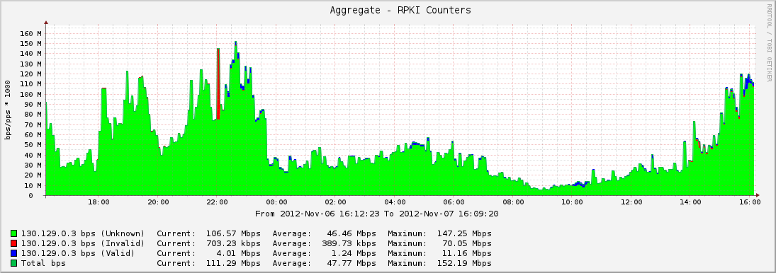
RPKI Statistics

Slide 7
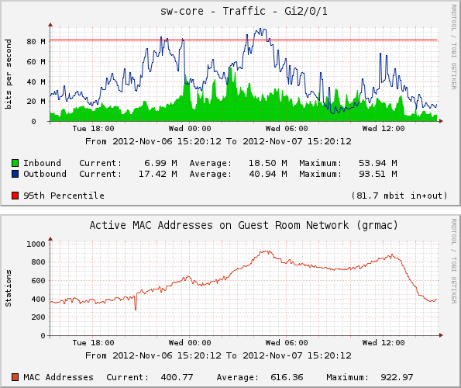
Guestroom Usage

Slide 8
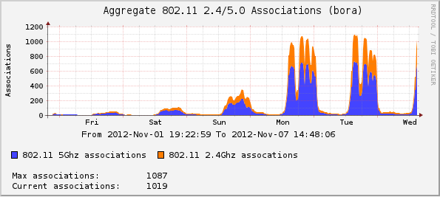
Wireless Associations

Slide 9
A special thanks to…
Bill Fenner (in abstentia)
Bill Jensen
Bjeorn Zeeb
Chris Elliot
Joel Jaeggli
Jim Martin
Warren Kumari
Brandon Height
James Dishongh
Lance Hollandsworth
Hans Kuhn
Nick Kukich
Edward McNair

Slide 10
Thank You
Comcast
Juniper
Connectivity
Gear Donation (Servers)
Gear donation (Routers)
Cisco
Google
Gear donation (Aps/Switches)
Gear donation (Servers)
Radiator
Software Licenses

